Slide 1
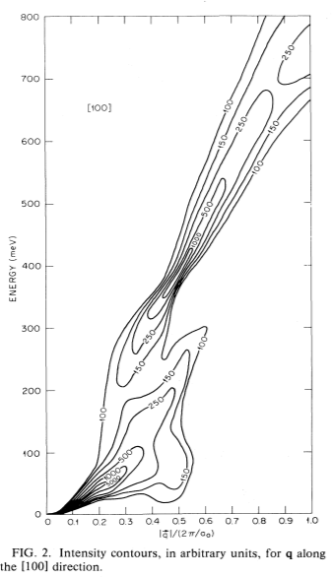
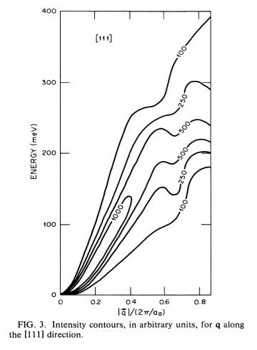
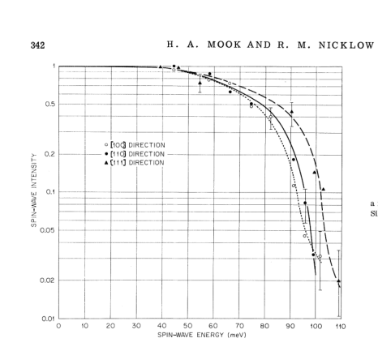
Spin wave excitations in Fe on the basis of band theory
Theory:
Experiment:
Blackman, J. A., Morgan, T. & Cooke, J. F. Prediction of High-Energy Spin-Wave Excitation in Iron. Phys. Rev. Lett. 55, 2814–2817 (1985).
Mook, H. A. & Nicklow, R. M. Neutron Scattering Investigation of the Magnetic Excitations in Iron. Phys. Rev. B 7, 336–342 (1973).

Slide 2


270
255
75

Slide 3
Looking for gap in 75-? mEv energy range
Exists:
Some vague pictures sowing evidence
Needed:
Better spherical cut
Resolution deconvolution
Symmetrisation

Slide 4
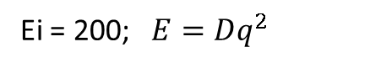
Ei = 200; $E=Dq^{2}$
Bragg 110, Directions [100] (ΓH), dE=2.5, dK=0.1
|D|=198 [meV*Α⁻²]
Bragg 1(-1)0, Directions [100] (ΓH), dE=2.5, dK=0.1
|D|=207 [meV*Α⁻²]
Bragg 200, Directions [100] (ΓH), dE=5, dK=0.1
|D|=230 [meV*Α⁻²]
dE=70-75, <±1,x,y> dK=0.2
dE=100-105, cut <0,x,y> dK=0.2
Gap

Slide 5
Looking for gaps in dispersion: Spherical Cut:

Slide 6
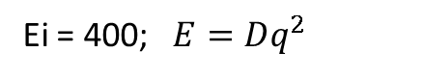
Ei=186 Bragg 200, Directions [100] (ΓH), dE=5, dK=0.1
|D|=237 [meV*Α⁻²]
Ei = 400; $E=Dq^{2}$
Bragg 110, Directions [100] (ΓH), dE=5, dK=0.1
|D|=237 [meV*Α⁻²]
Bragg 200, Directions [100] (ΓH), dE=5, dK=0.1
|D|=230 [meV*Α⁻²]
SW intersection observed at dE~250 in direction 200->3(-1)0?
Gap?

Slide 7
Searching for sw “Roof” at point “N” (1/2,1/2,0) at 250 mEV
Exists:
Pictures showing rooftop
Needed:
Q-dE cut

Slide 8
Catching N point (½, ½,0)
Ei=401
Ei=787
dE=200+20
dE=200+20
Ei=787
dE=220+20
dE=220+20
dE=220+20
dE=240+20
dE=240+20
dE=240+20
Π-no
- spur
dE=260+20
dE=260+20
dE=260+20
dE=280+20
dE=280+20
dE=360+20
Ei=787
dE=300+20
dE=320+20
dE=340+20
Removed background

Slide 9
Symmetrized cuts:
Ei 400; 111 (u=[1,-1,1])

Slide 10
Ei 400; 111 (u=[1,-1,-1])

Slide 11
Peak [1,1,0], Heisenberg model:
With magFF
No magFF
Peak [1,1,0], Parabolic model:
With magFF
No magFF

Slide 12
Tobyfitting, parab model:
Peak [1,1,0]
FHHW+errors
SW amplitude + errors
Peak [1,1,0] direction [1,0,0]

Slide 13
Peak [2,0,0]

Slide 14
Peak [1,1,0], 2peaks approximation, parab SW:
FHHW+errors

Slide 15
Ei200 Peak [2,0,0], direction <111>
Ei400 Peak [1,1,0], direction <100>

Slide 16
Peak [1,1,0],dir <100>, lattice 2.86 Heisenberg model fitting :
SW amplitude + errors
FHHW+errors
Peak [1,1,0],dir <100>, lattice 2.84 Heisenberg model fitting :
SW amplitude + errors
FHHW+errors
Cut: [1,1,0] Direction: [1,0,0] J : 29.6279 Sig: 0.097528; Cut: [1,1,0] Direction: [0,1,0] J : 25.5337 Sig: 0.2565
Cut: [1,1,0] Direction: [0,0,1] J : 25.3623 Sig: 0.24648

Slide 17
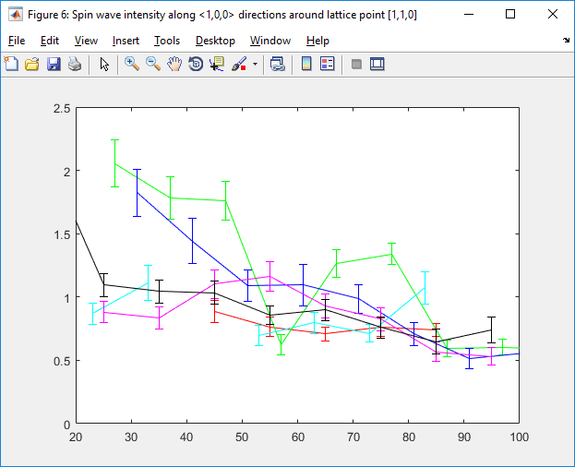
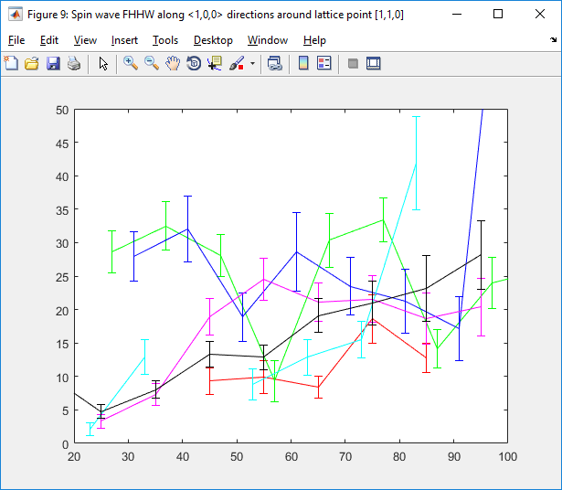
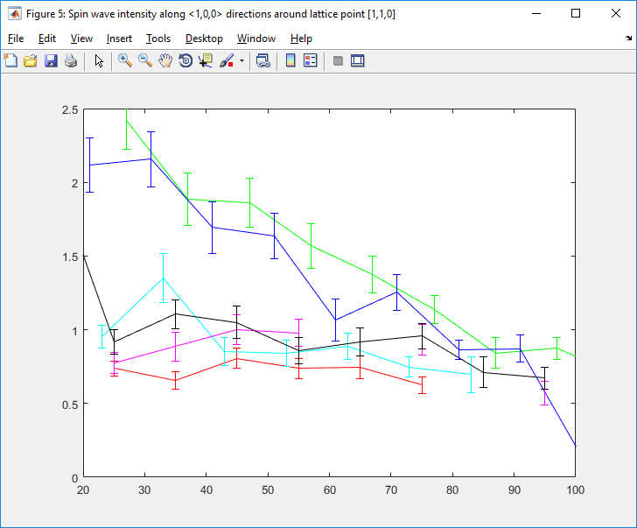
Peak [1,1,0], dir <1,1,0> Heisenberg model, Ei=200:
Realigned:

Slide 18
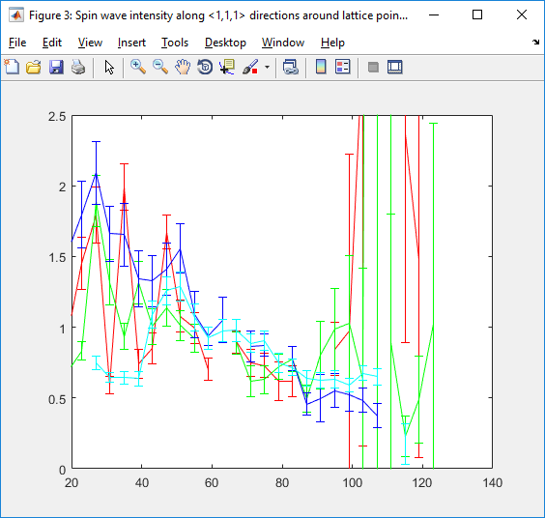
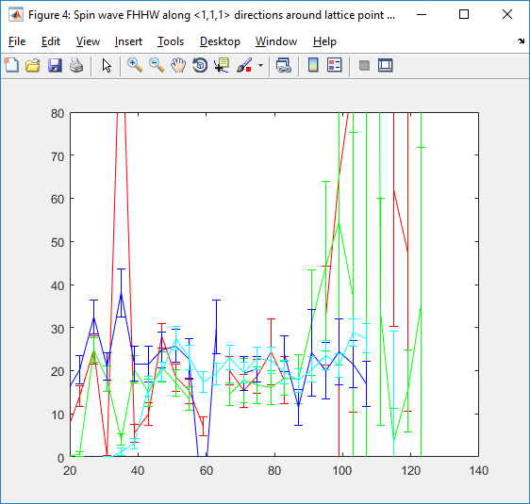
Peak [1,1,0], dir <1,1,1> Heisenberg model, Ei=200:
Realigned:
Cut: [1,1,0] Direction: [1,1,1] J : 26.0365 Sig: 0.077748
Cut: [1,1,0] Direction: [1,-1,1] J : 27.7654 Sig: 0.13421
Cut: [1,1,0] Direction: [1,-1,-1] J : 27.9709 Sig: 0.27515
Cut: [1,1,0] Direction: [1,1,-1] J : 27.2034 Sig: 0.071099

Slide 19
Peak [1,1,0], dir <1,0,0> Heisenberg model, Ei=400:
SW amplitude + errors
SW amplitude + errors (realigned a=2.84)
FHHW+errors
FHHW+errors (realigned)

Slide 20
Peak [1,1,0], dir <1,1,0> Heisenberg model, Ei=400:
SW amplitude + errors

Slide 21
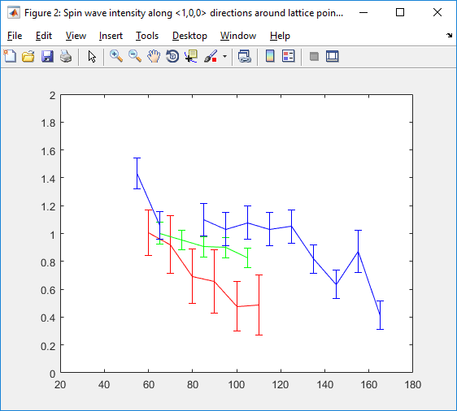
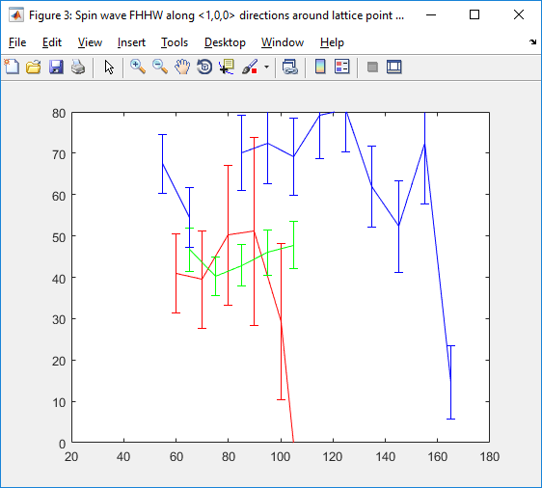
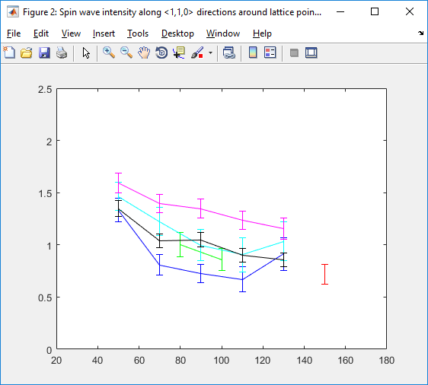
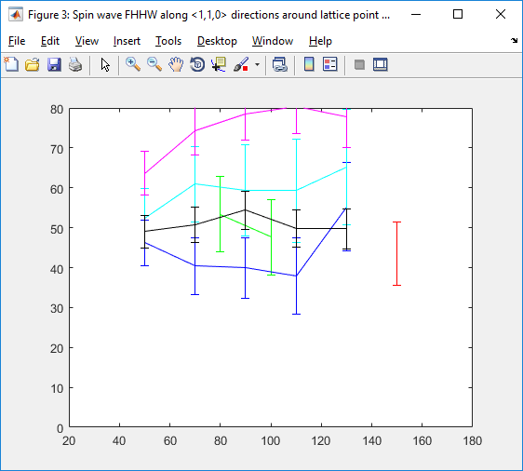
Peak [1,-1,0], dir <1,0,0> Heisenberg model, Ei=787:
Cut: [1,-1,0] Direction: [1,0,0] J : 27.6552 Sig: 1.2569; Cut: [1,-1,0] Direction: [0,1,0] J : 30.4969 Sig: 0.56687
Cut: [1,-1,0] Direction: [0,0,1] J : 35.9077 Sig: 0.66817
Peak [1,-1,0], dir <1,1,0> Heisenberg model, Ei=787:
Cut: [1,-1,0] Direction: [1,1,0] J : 30.1267 Sig: 0.95236; Cut: [1,-1,0] Direction: [1,-1,0] J : 35.4225 Sig: 1.4114
Cut: [1,-1,0] Direction: [1,0,1] J : 30.914 Sig: 0.78239; Cut: [1,-1,0] Direction: [1,0,-1] J : 35.2996 Sig: 1.3725
Cut: [1,-1,0] Direction: [0,1,-1] J : 34.9945 Sig: 0.52071

Slide 22
Realigned Fe401:
Old:
New:

Slide 23
Realigned Fe200:
Old:
New:

